Slide 1
Making Punnett Squares

Slide 2
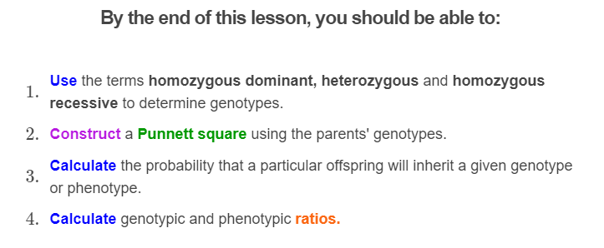
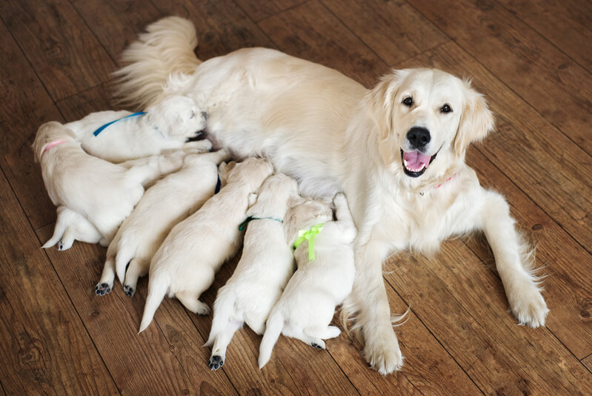

Slide 3

Punnett squares are useful tools for illustrating the possible genotypes and phenotypes of offspring.
You have learnt how to read a Punnett square, but now we are going to practice making them.

Slide 4
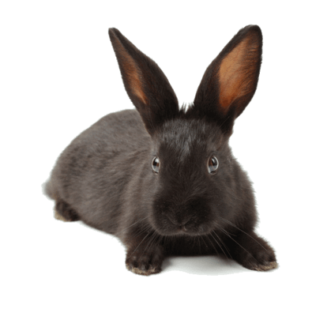
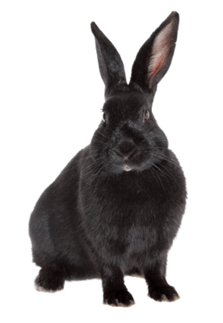
We will make a Punnett square step by step for these two rabbits.
They have a gene that controls their fur colour. The dominant allele (F) codes for black fur and the recessive allele (f) codes for white.
Both rabbits are heterozygous, meaning they have one dominant and one recessive allele. This gives them the genotype Ff.
Because the black fur trait is dominant, both rabbits have the black fur phenotype.

Slide 5
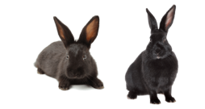
It is important to know the difference between genotypes and phenotypes.
An individual's alleles make up their genotype. An individual's traits make up their phenotype.
So these rabbits have the genotype Ff and the phenotype of having black fur.

Slide 6
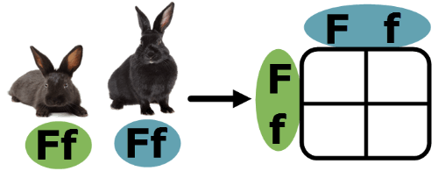
To make a Punnett square, start off by drawing a square with four boxes in it.
Then add the alleles of one parent along the top and the other parent along the side. These alleles represent the parent's gametes.
Remember, the capital letter represents the dominant allele and the lower case represents the recessive allele. In this case, the dominant allele codes for black fur and the recessive allele codes for white fur.

Slide 7
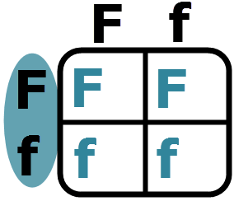
Now, we need to fill in the centre.
Start by looking at one parent. The parent on the left has one big F and one little f.
The capital F is next to the top row so goes in the top boxes. The lowercase f is is next to the bottom row so goes in the bottom boxes.

Slide 8
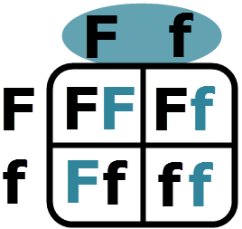
We then look at the other parent.
They also have the genotype Ff. The F is above the left column so we put F in the left boxes. The f is above the right column so we put f into the right boxes.
Always place the dominant allele first. So in the lower left box Ff is correct. fF is not!

Slide 9
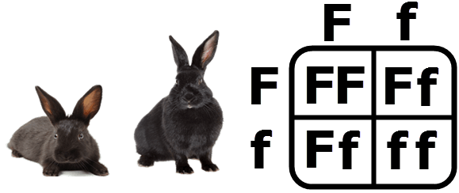
We now have our finished Punnett square.
Remember, to fill in a Punnett square write down the parents' alleles first. Then fill in the center looking at one parent at a time.
And always place the dominant allele first! (E.g. Ff, not fF.)

Slide 10

So far you have been told the parents' genotypes when making Punnett squares.
However, there are times when you will need to figure them out from their phenotypes. To do this, you just need to remember how dominant and recessive traits work.

Slide 11
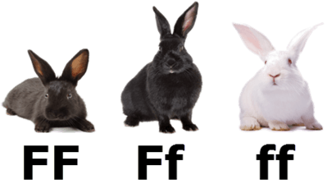
Remember, the dominant allele will hide the recessive.
So individuals will have the dominant phenotype if they are heterozygous (Ff) or if they are homozygous dominant (FF).
Individuals with the recessive phenotype will always be homozygous recessive (ff).

Slide 12
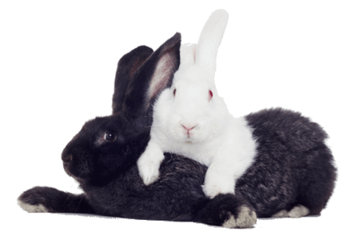
Let's practice deducing genotypes from phenotypes using rabbits.
In this hypothetical rabbit breed, individuals have black or white fur.
The allele for black fur (F) is dominant over the white fur allele (f).

Slide 13
Below are three rabbits.
On the right we have a white furred rabbit. White is recessive to black, so that rabbit must be homozygous recessive (ff).
In the centre is a black furred rabbit. It could have the genotypes Ff or FF. Fortunately, we have another piece of information: this rabbit is heterozygous. So it must have the genotype Ff.
On the left is another black furred rabbit. This one is homozygous dominant, so has the genotype FF.

Slide 14
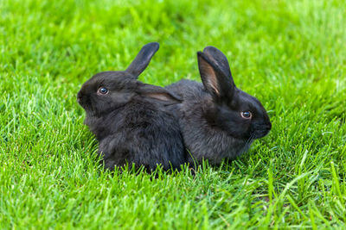
Here is a quick test to see if you can determine a parent's genotype.
There are two black rabbits. Rabbit A is heterozygous. Rabbit B is homozygous dominant.
Determine their genotypes. Check out the next slide to see if you got it right.

Slide 15
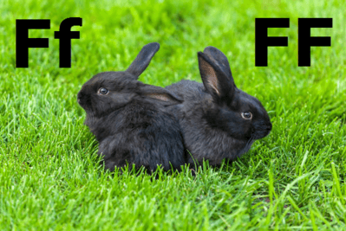
Answer: Rabbit A has the genotype Ff and B has the genotype FF.
Rabbit A is heterozygous, meaning it has two different alleles. This must be one for black fur (F) and one for white fur (f).
Rabbit B is homozygous, so has two of the same allele. This could be two for black fur (FF) or two for white (ff) but we also know that these alleles are dominant, meaning it must be FF.

Slide 16

Now you can construct Punnett squares!
However, that is not much use if you don't know how to read them. We will quickly recap how to do this.

Slide 17

When reading Punnett squares, you need to be able to do two things.
First, you need to be able to determine the probability that a particular offspring will inherit a particular genotype or phenotype.
Second, you need to be able to make genotypic and phenotypic ratios to show what proportion of offspring will inherit each genotype or phenotype.

Slide 18
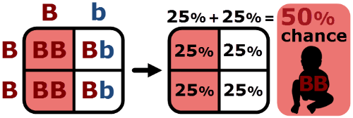
To find probabilities, just remember that each of the four inner boxes has a 25% chance of occurring.
If a genotype (or phenotype) appears in more than one box, add the 25% probabilities of the boxes it comes in to find the overall probability for that genotype (or phenotype).

Slide 19
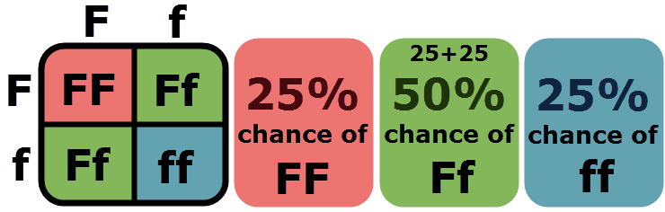
For example, in the Punnett square below, only one box has the genotype FF, two have Ff and one has ff.
So a particular offspring has a 25% chance of inheriting the FF genotype, a 50% (25+25) chance of inheriting Ff and a 25% chance of inheriting ff.

Slide 20
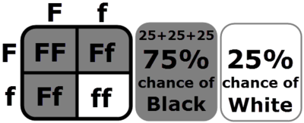
Similarly, three of these boxes result in black fur and one in white.
So the offspring has a 75% chance of having black fur and a 25% chance of having white.

Slide 21
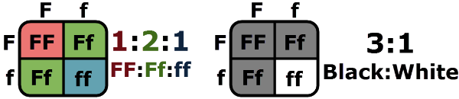
Finding ratios is even easier.
Just count the number of boxes containing each genotype (or phenotype)!
In this Punnett square, one box has the genotype FF, two have Ff and one has ff. This makes the genotypic ratio 1:2:1 (FF:Ff:ff).
Three of these boxes result in black fur and one results in white fur. This makes the phenotypic ratio 3:1 (black:white).

Slide 22
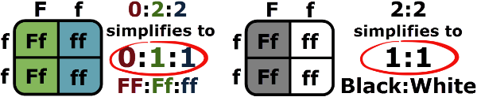
You should always simplify your ratios whenever possible.
The Punnett square below has two boxes with the genotype Ff and two with ff.
This make the genotypic ratio 0:2:2, which simplifies to 0:1:1.
It also makes the phenotypic ratio 2:2, which simplifies to 1:1.

Slide 23
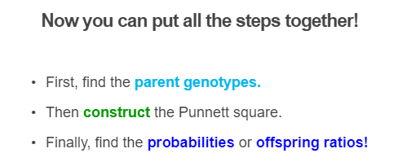


Slide 24
